Slide 1
ICS Midterm Review Session
By Yifan Billy

Slide 2
Agenda
Algorithms
Big-O Notation
Recursion
Sorting
Searching
Dynamic Programming
OOP
A “class”
Operator Overloading
Inheritance
“_” and “__”
Decorators and Iterators
Matplotlib and Copy

Slide 3
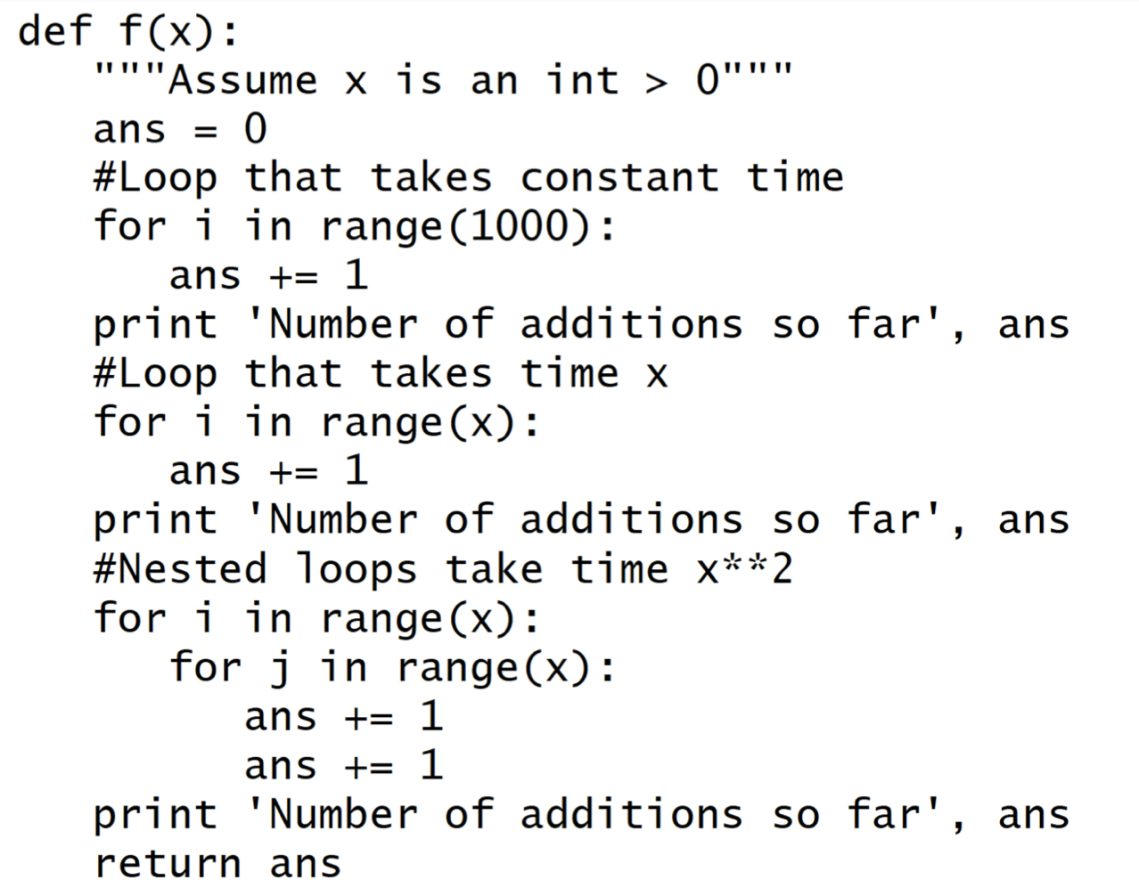

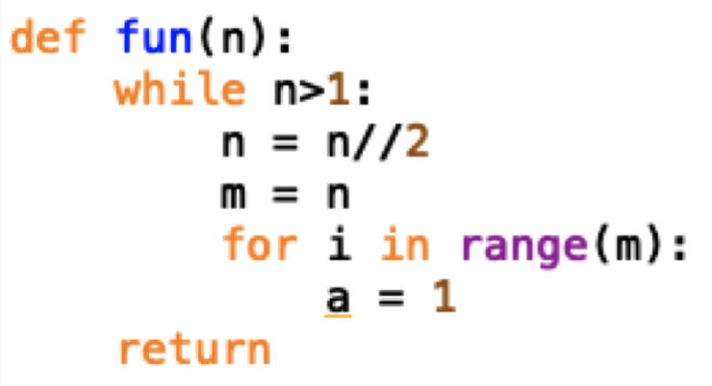
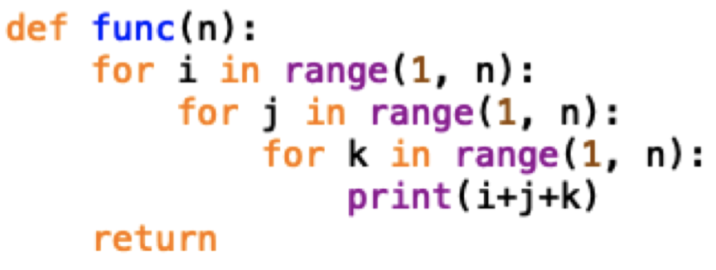
Algorithms: ordered set of executable steps to accomplish a task
Big-O Notation:
O(1): operations done in time irelevant to input n
Assignment operation: a=1;
List operations: len(my_list);
For-loops: for i in range(10000);
O(n): loop through 1 to n one-by-one
For-loops: for i in range(n)
While-loops: while i<n: {i+=1;}
O(logn): loop through 1 to n exponentially
While-loops: while i<n: {i*=2;}
Nested Loops: O(loop1*loop2)
Parallel Loops: O(loop1+loop2)=O(more complex loop)

Slide 4
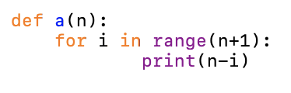
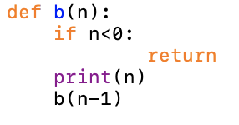
Recursion: a function that calls itself
Usual construction of a recursion function:
Base case
Loop structure
Similar to a for-loop

Slide 5
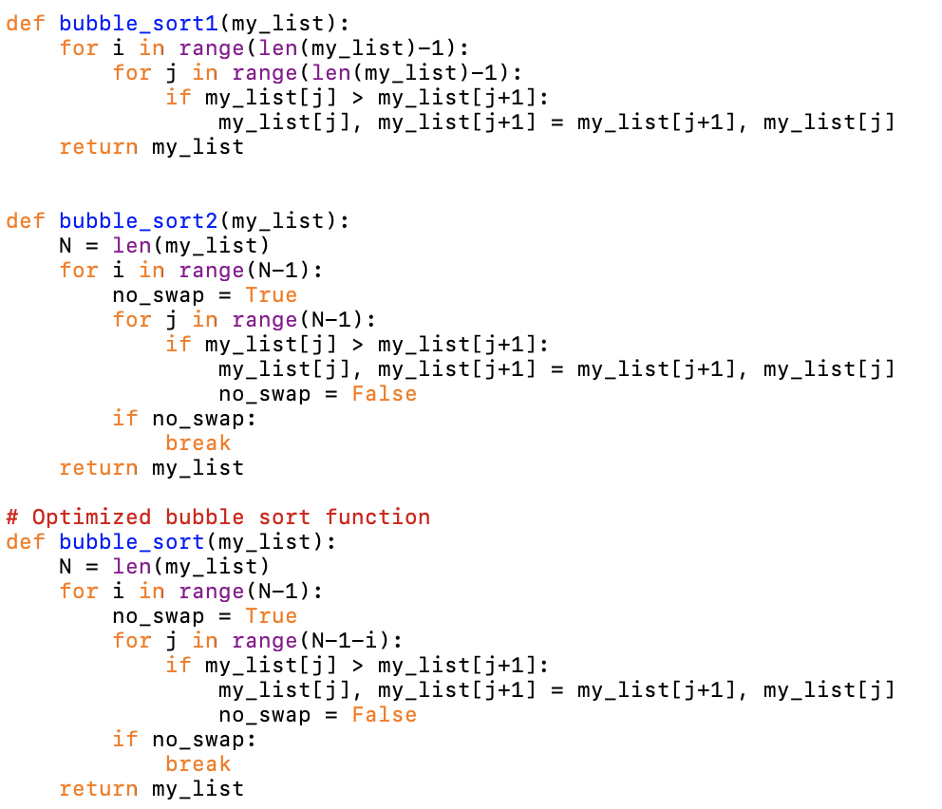
Bubble Sort
Swap if my_list[j] is greater than my_list[j+1]
After i-th iteration, my_list[-i:] is sorted
Optimization: Stop the loop if my_list is sorted
Runtime complexity: O(n^2)

Slide 6
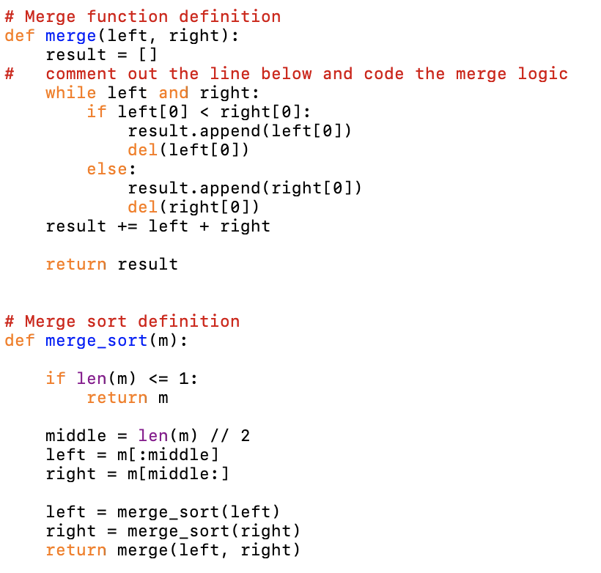
Merge Sort
Recursion
Runtime complexity: O(nlogn)

Slide 7
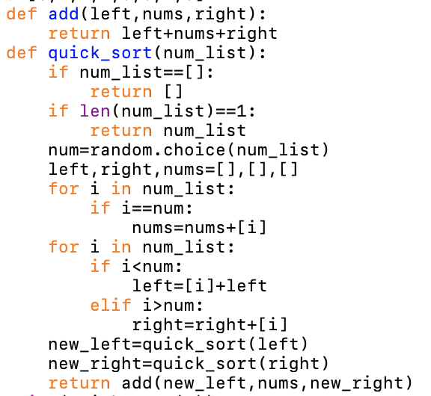
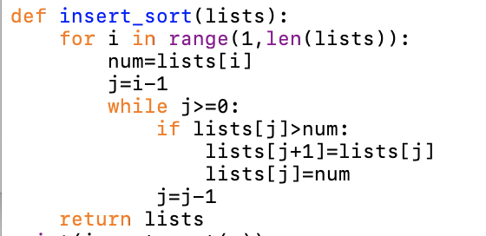
Insertion Sort / Quick Sort

Slide 8
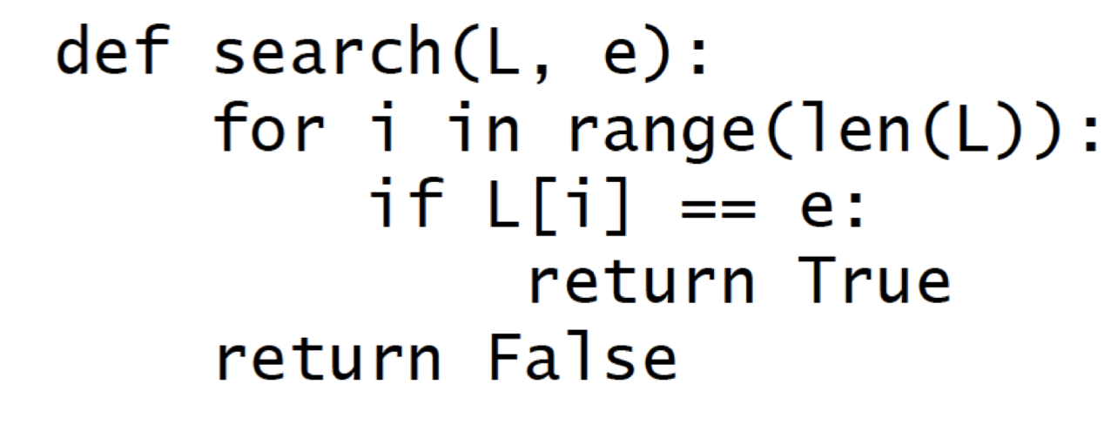
Linear Search

Slide 9
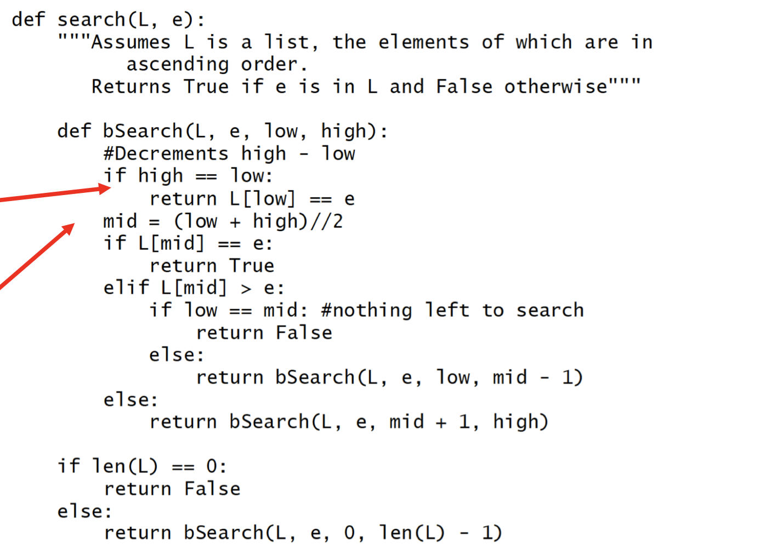

Binary Search

Slide 10
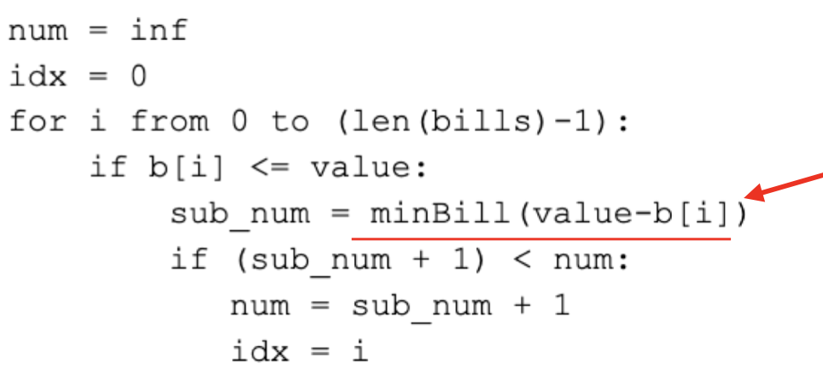

Dynamic Programming: Top-down approach of the problem
Knapsack Problem:
Knap(i, L)=max(Knap(i+1,L),Knap(i+1,l-w_i)+v_i)

Slide 11
OOP: A “Class”
Object a
Attributes 1 = Value a1
Attributes 2 = Value a2
Attributes 3 = Value a3
...
Attributes
“属性”
Class
Object b
Attributes 1 = Value b1
Attributes 2 = Value b2
Attributes 3 = Value b3
...
“能动性”
Methods
Object c
Attributes 1 = Value c1
Attributes 2 = Value c2
Attributes 3 = Value c3
...
…...

Slide 12
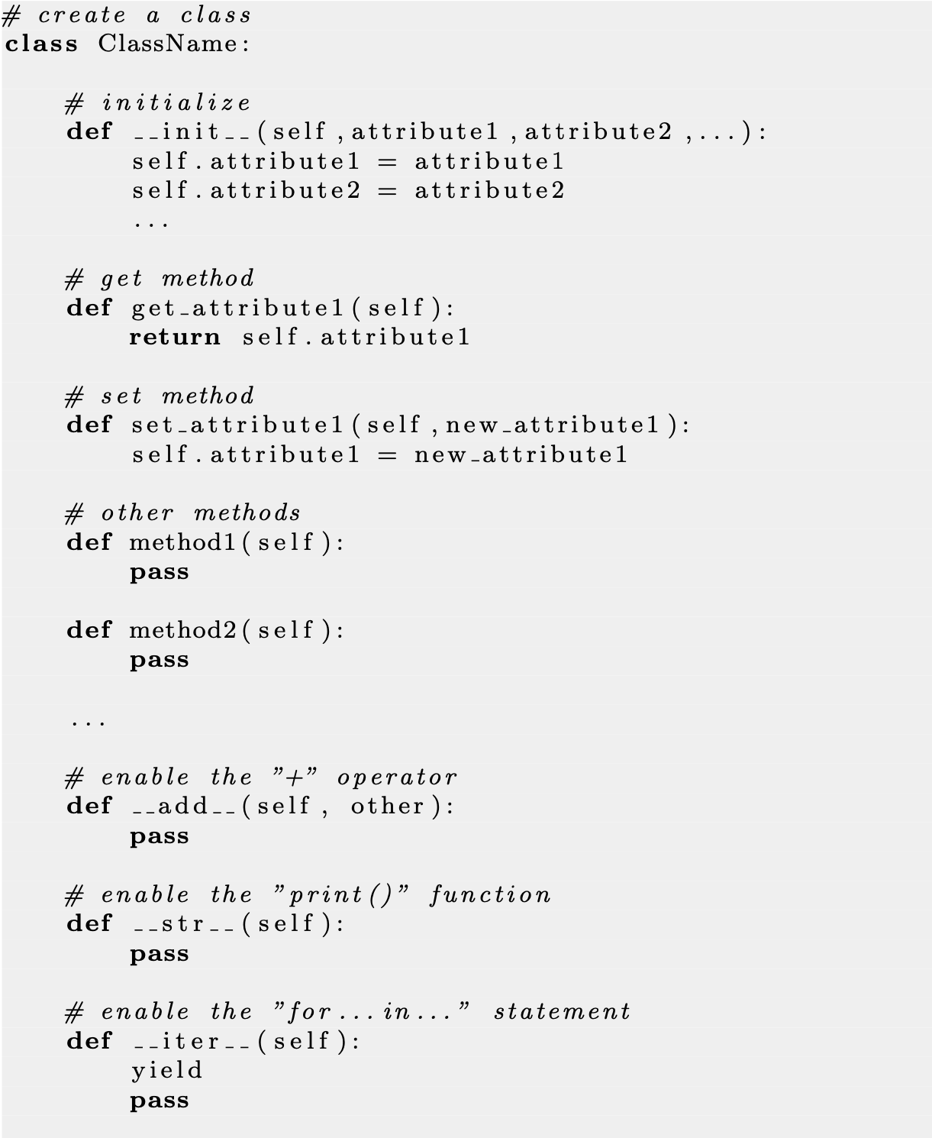
“self”

Slide 13
“getters”
and
“setters”
Why should we have getters?
--Encapsulation--

Slide 14
OOP: Operator Overloading
Predefined methods
“__***__”
__init__
__add__
__str__
__iter__
__next__
__eq__
__len__
__lt__
…...

Slide 15
the_sum = object_1 + object_2
print(object_1)

Slide 16
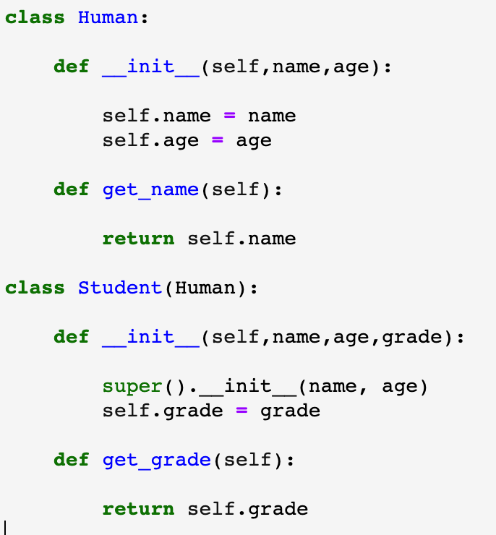
OOP: Inheritance
Inheritance allows a new class to extend an existing class.
The new class inherits the data attributes and methods of the class it extends.

Slide 17
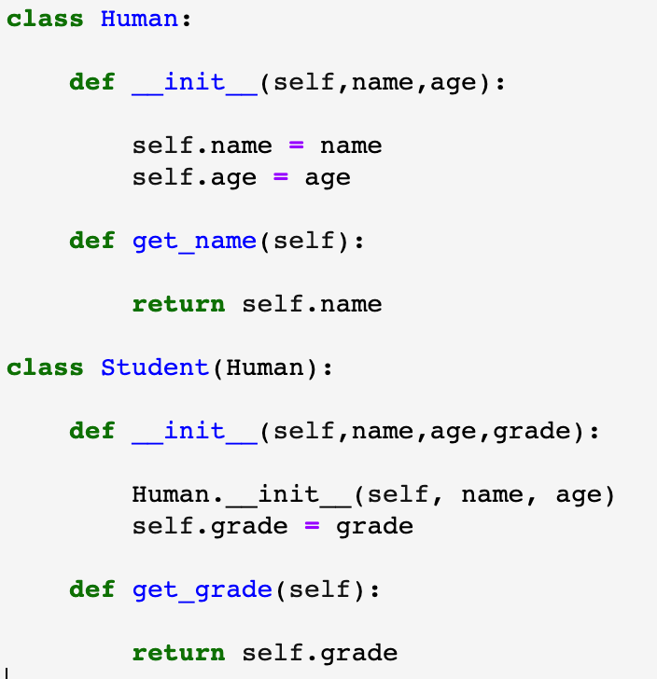
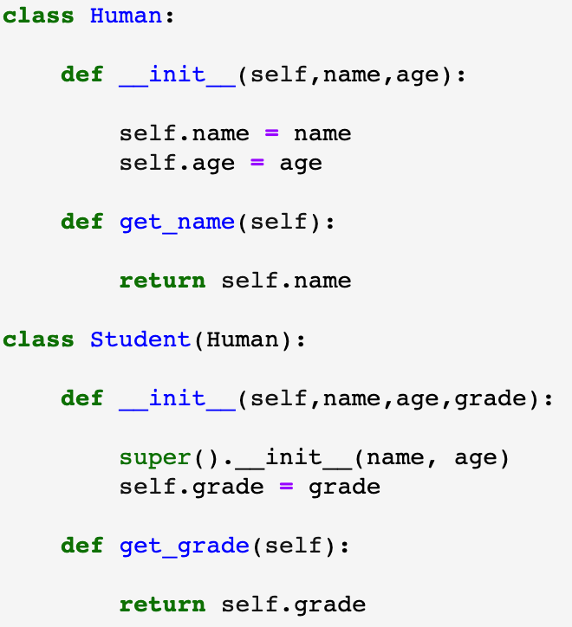
Understand “super()”.

Slide 18
Some functions.
dir()
Function overloading
isinstance(instance, class_name) issubclass(sub, super)

Slide 19
Now, you have learned all three pillars of OOP.
Inheritance!
Encapsulation!
Polymorphism!

Slide 20
OOP: “_” and “__”
“_”: Weekly hidden
“__”: Strongly hidden
Why do we have “_” and “__”?
Encapsulation!

Slide 21
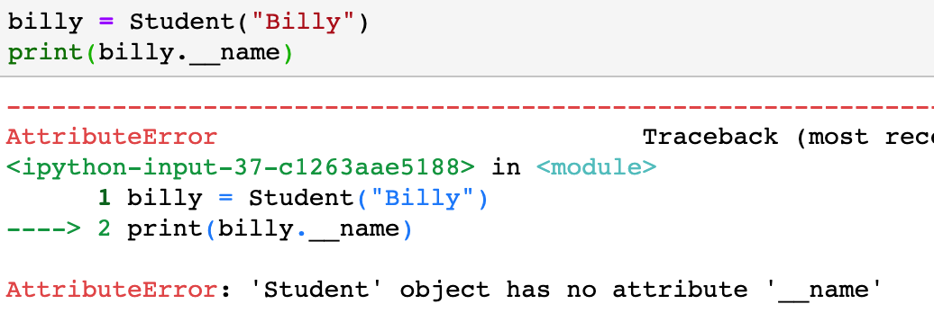
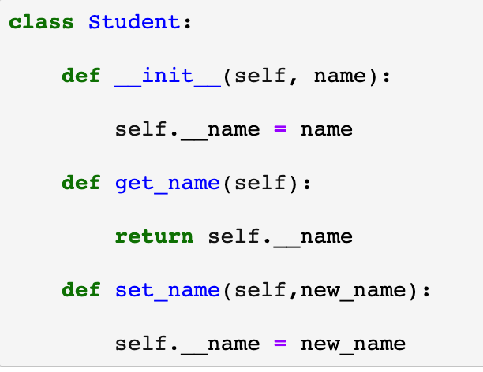
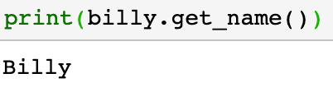
That’s why we have getters and setters!

Slide 22
OOP: Decorators and Iterators
@property
getter
Decorators: @***
@property_name.setter
@staticmethod
…...

Slide 23
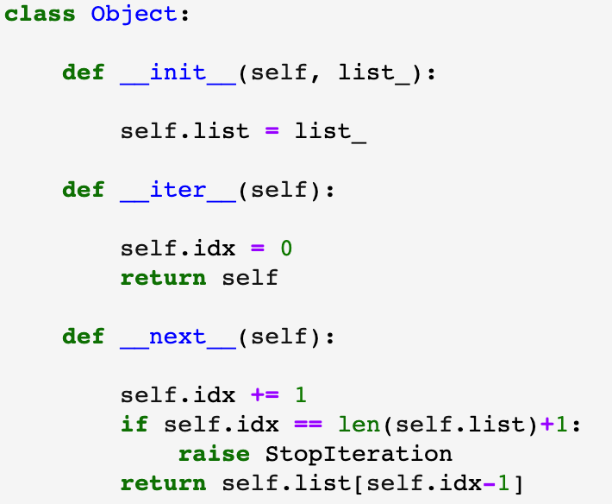
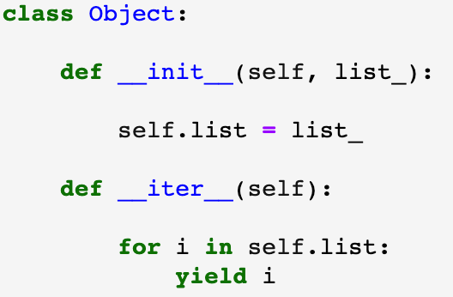
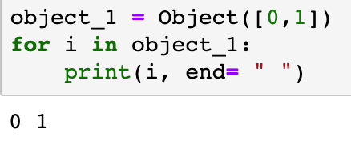
Iterators

Slide 24
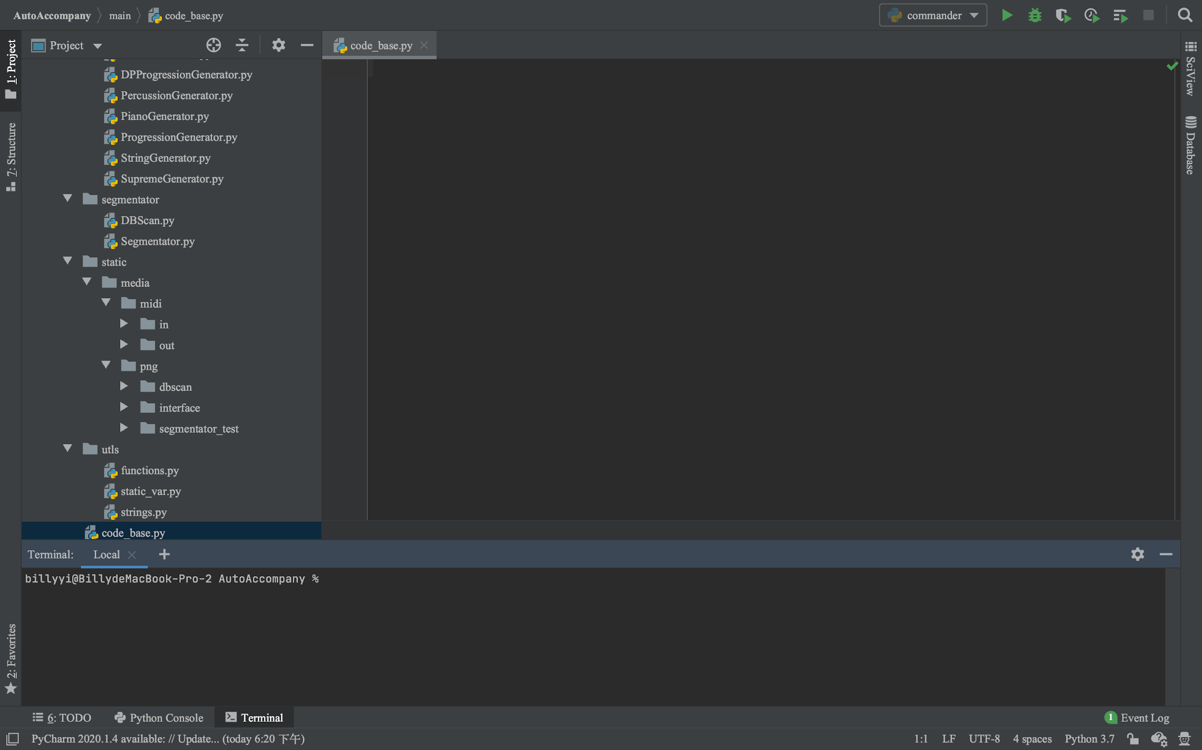
OOP: Matplotlib and Copy
Make sure you have installed Matplotlib!
>>>pip3 install matplotlib
>>>If your IDE still tells you it cannot find Matplotlib after you have installed, try install Matplotlib in your IDE’s terminal.

Slide 25
Probably no Matplotlib in midterm, but will be a important part in final!
No need to code by yourself, but have to understand.
>>>from matplotlib import pyplot as plt
>>>plt.plot(x, y, “ro”, marker = “*”, ...)
>>>plt.show()

Slide 26
A list (numpy array) of x data
E.g. x = np.arange(0, 3 * np.pi, 0.1)
Other attributes
plt.plot(x, y, “ro”, marker = “*”, ...)
A list (numpy array) of y data
E.g. y = np.sin(x)
The color, marker and line

Slide 27
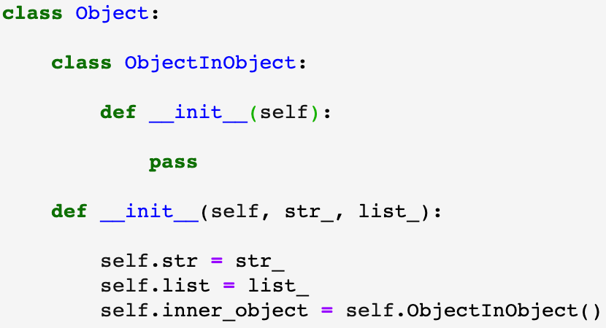
Copy
>>>import copy
>>>object_1 = Object(“1”, [0, 1])
>>>object_2 = object_1
>>>object_3 = copy.copy(object_1)
>>>object_4 = copy.deepcopy(object_1)

Slide 28
 | “=” | “copy” | “deepcopy”
Str (immutable) | same | different | different
List (mutable) | same | different | different
Inner object | same | same | different
“Same” means when you change an attribute of object 1, it will also change the corresponding attribute of object 2

Slide 29
Q & A

Slide 30
Thank you!
Do Well in Midterm!
Produced by Yifan and Billy

